Slide 1
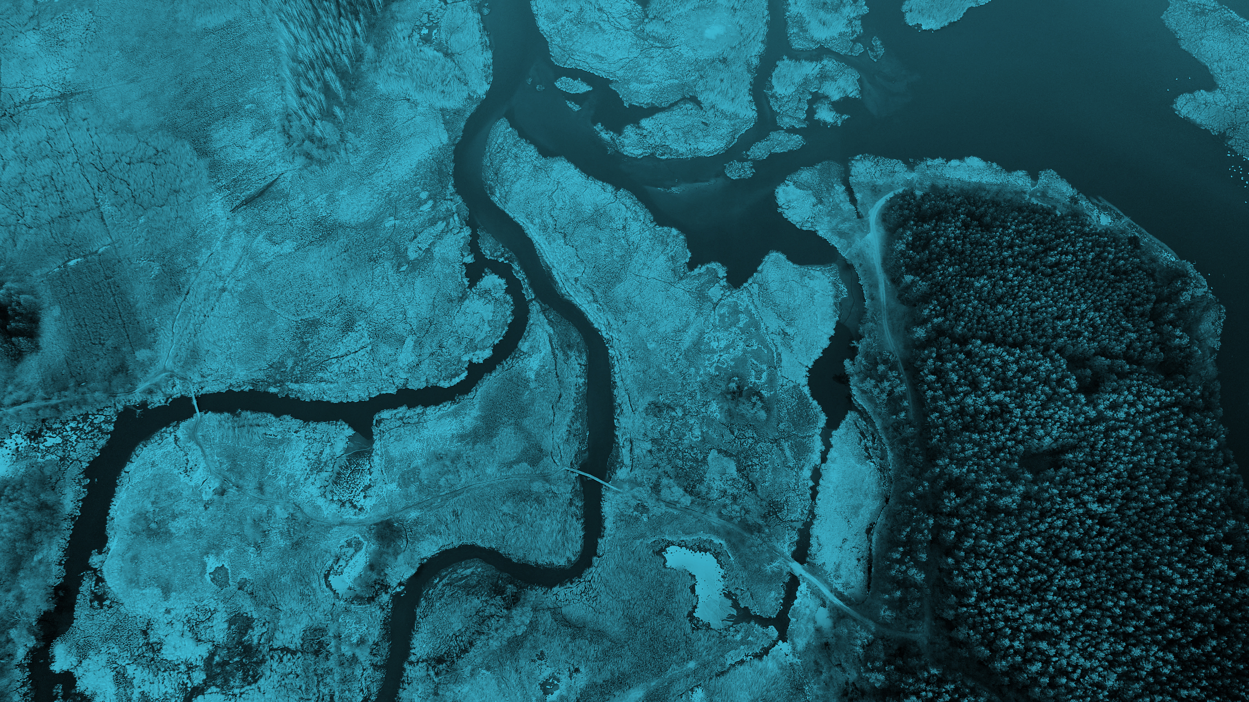
The Blue Peace Index 2020: Central Asia
Challenges and opportunities
Matus Samel
Sustainability, Climate Change and Resources practice
The Economist Intelligence Unit

Slide 2
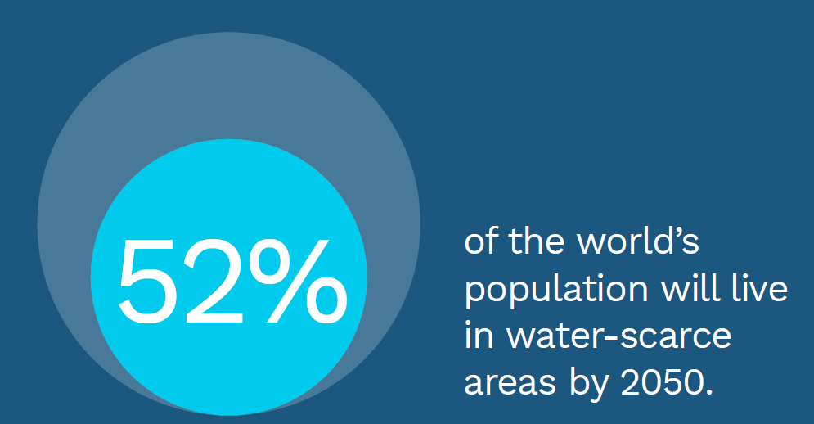
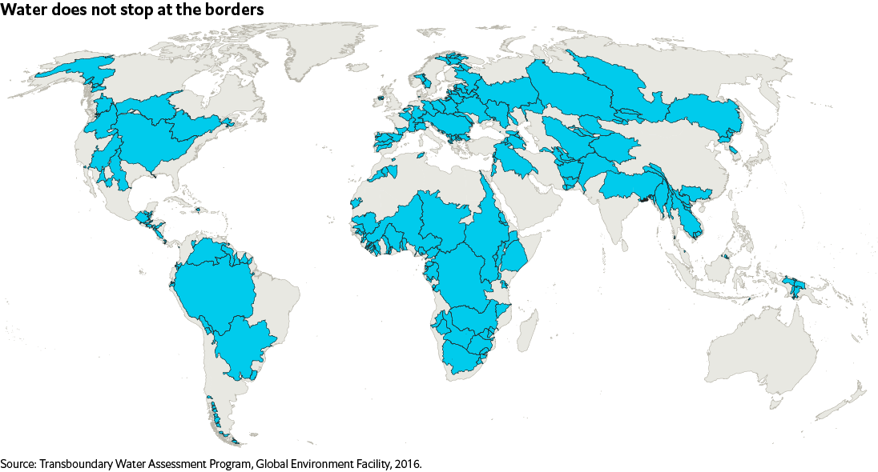
Freshwater is scarce and doesn’t stop at the borders
Global Transboundary River Basins

Slide 3
Why did we build the Blue Peace Index?
Blue Peace Index will…
Bring the topic to a “non-specialist” audience
Highlight policy and investment needs and opportunities
Spur a public debate on goals and best practices
Provide a tool for a holistic & long-term assessment

Slide 4
How did we build the Blue Peace Index
Phase 1 – Framework Design
Conducted Literature Review and Data Audit
Interviewed stakeholders (public and private sector)
Hosted Expert Panel
Index Covers:
30 countries
7 basins:
Amazon
Amu Darya
Mekong
Sava
Senegal
Syr Darya
Tigris/Euphrates
Phase 2 – Country and Basin Scoring
Compiled 50+ qualitative indicators based on existing (SDG6) and new questions
Collated data for ~30 quantitative indicators
Focused on capturing stakeholder activities/agency
Phase 3 – Dissemination and Engagement
Launched Blue Peace Index and Blue Peace Website
Published report, workbook, infographic and video
Presented at multiple conferences and roundtables

Slide 5
What does the Blue Peace Index measure?
Five Pillars
Policy and Legal Frameworks
Institutions and Participation
Water Management Instruments
Infrastructure and Financing
Cooperation Context
Indicators
Basin Level Scores
Quantitative and qualitative indicators selected and assessed, based on expert consultations and data availability.
Combine national and basin level indicators in each pillar

Slide 6
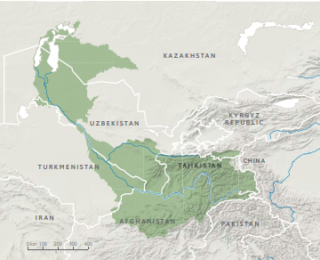
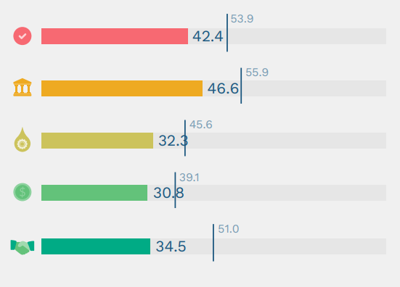
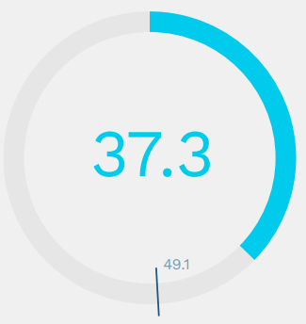
|
Snapshot of Findings: Amu Darya
Overall Score
Challenges: Basin-level cooperation is mostly limited to water allocation and technical capacity activities. Sustainability is not adequately incorporated in national economic development strategies. Exaggerated by relatively high levels of political risk and low intra-regional economic integration.
Opportunities: Some signs of progress on better engagement between riparians, and market reforms on national level. Increased inclusion of Afghanistan in the dialogue has been encouraging. Key area for improvement is the general institutional and governance capacity at both the domestic and regional level.

Slide 7
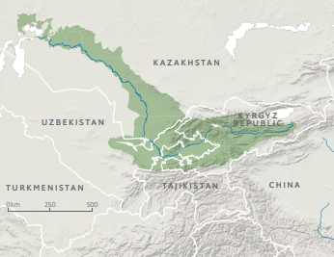
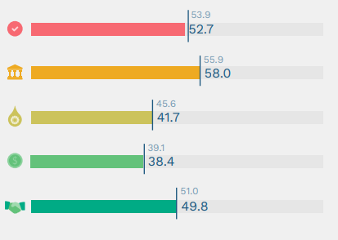
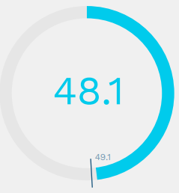
|
Snapshot of Findings: Syr Darya
Overall Score
Challenges: Basin-level arrangements lack the tools and capacity to effectively carry out broader transboundary water management. At the regional and national level, water investment and infrastructure remains inadequate, and lack private participation.
Opportunities: Some bilateral and multilateral efforts in areas, such as joint assessment, pollution control, and disaster management exist, but are limited and should be further developed. Existing platforms for data and information publication should be developed further. On national level, overall investment climate has been improving in recent years.

Slide 8
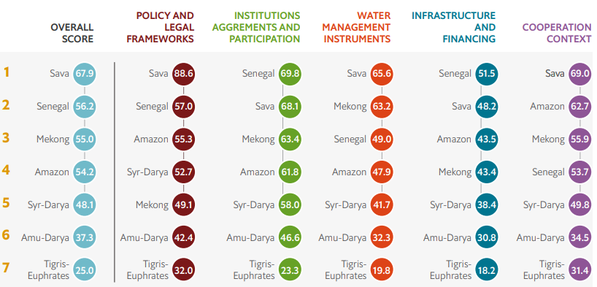
Overview of Findings

Slide 9
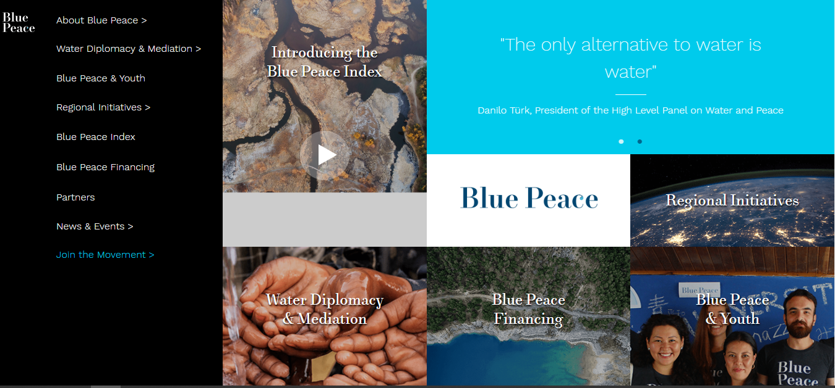
Find out more at:
bluepeaceindex.eiu.com

Slide 10
Appendix

Slide 11
Who we worked with
Expert Panel
Basin Experts
Contributed to framework and indicator design:
Dr. Christian Bréthaut, Geneva Water Hub
Dr. James Dalton, International Union for Conservation of Nature (IUCN)
Dr. Alan Nicol, International Water Management Institute (IWMI)
Ms. Belynda Petrie, OneWorld Sustainable Investments
Dr. Benjamin Pohl, adelphi
Prof. Alistair Rieu-Clarke, Northumbria School of Law
Dr. Susanne Schmeier, IHE Delft
Mr. Alex Simalabwi, Global Water Partnership
Prof. Mark Zeitoun, University of East Angelia
Contributed to reporting on basin characteristics:
Dr Iskandar Abdullaev, Deputy Director, CAREC
Ms Dinara Ziganshina, Deputy Director, SIC ICWC
Mr Bulat Yessekin, Kazakhstan Green Economy National Council expert
Mr Talaibek Makeev, Regional Technical Advisor, UNDP- Kazakhstan
Ms Jenniver Sehring, Senior Lecturer in Water Governance and Diplomacy, IHE Delft Institute for Water Education
Mr Bo Libert, Consultant, SIWI
Mr Igor Petrakov, Legal expert on International Water Resources Management, Kazakh University
Mr Kakhramon Djumaboev, Research Fellow, International Water Management Institute (IWMI)
Ms Bota Sharipova, Central Asia Youth for Water Network

Slide 12
National water policy
National environmental policy
International water conventions
Basin water policy framework
Policy and legal
National water agency
National stakeholder engagement
National data sharing
Basin level body
Basin stakeholder engagement
Basin data sharing
Water Stress
Socio-economic exposure
Political stability
Propensity for conflict
Economic relations with neighbouring states
Cooperation Context
Institutions and participation
What is included in the Index?
Water availability management
Pollution control
National disaster management
Basin water availability management
Basin disaster management
Infrastructure and financing
Water management instruments
National public investment
Private sector investments
Investment climate
Basin organisation financing
Basin infrastructure financing

Slide 13
Blue Peace Index Pillars (1/3)
Policy and Legal Frameworks
Institutions and Participation
1.1 National water policy National water legislation and policies and application of integrated water management principles.
1.2 National environmental policy National policies for limiting water pollution and transboundary environmental impact.
1.3 International water conventions Ratification of international water conventions.
1.4 Basin water policy framework Existence and comprehensiveness of international transboundary water agreements.
2.1 National water agency Existence and capacity of a national water agency.
2.2 National stakeholder engagement National programmes for engaging key water policy stakeholders, such as government agencies, user associations and the broader public.
2.3 National data sharing National platforms for sharing data between government agencies and the broader public.
2.4 Basin level body Existence and capacity of a joint basin-level operational institution.
2.5 Basin stakeholder engagement Basin-level programmes for engaging key water policy stakeholders, such as government agencies, user associations and broader public.
2.6 Basin data sharing Basin-level platforms for sharing data between government agencies and the broader public.

Slide 14
Blue Peace Index Pillars (2/3)
Water Management Instruments
Infrastructure and Financing
3.1 Water availability management National water monitoring and water use efficiency programmes.
3.2 Pollution control National water pollution control strategies and programmes.
3.3 National disaster management National plans for disaster management and climate change adaptation.
3.4 Basin water availability management Joint basin-level water-monitoring and assessment programmes.
3.5 Basin pollution control Joint basin-level water pollution control strategies and programmes.
3.6 Basin disaster management Joint basin-level disaster monitoring and response strategies and programmes.
4.1 National public investment National public funding for the development of water resources, including infrastructure.
4.2 Private sector investment Availability and involvement of private funding for the development of water resources, including infrastructure.
4.3 Investment climate Overall national investment climate, including ease of doing business and regulatory and financial risks.
4.4 Basin organisation operational financing Funding for a joint basin-level institution and joint investment programmes.
4.5 Basin infrastructure financing Private sector involvement and alternative sources of funding for joint basin-level investment

Slide 15
Blue Peace Index Pillars (3/3)
Cooperation Context
5.1 Water stress National water availability and quality.
5.2 Socio-economic exposure Countries’ socio-economic exposure to changes in water availability
5.3 Political stability Government stability, security situation and broader political and social.
5.4 Propensity for conflict Level of militarisation and existence of water-related conflicts.
5.5 Economic relations with neighbouring states Economic integration of countries in the basin.

